Slide 1
B + TREE

Slide 2
Introduction
B+ Tree is an extension of B Tree which allows efficient insertion, deletion and search operations.
In B Tree, Keys and records both can be stored in the internal as well as leaf nodes.
Whereas, in B+ tree, records (data) can only be stored on the leaf nodes while internal nodes can only store the key values.
The leaf nodes of a B+ tree are linked together in the form of a singly linked lists to make the search queries more efficient

Slide 3
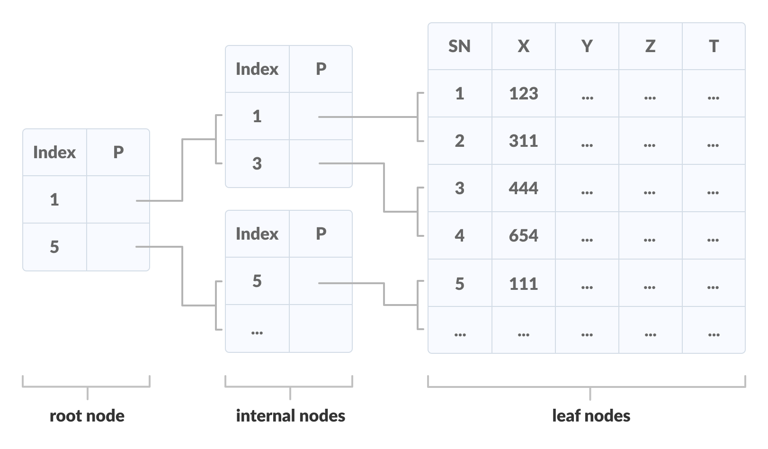
Multilevel Indexing

Slide 4
Advantage
Advantages of B+ Tree
Height of the tree remains balanced and less as compare to B tree.
We can access the data stored in a B+ tree sequentially as well as directly.
Keys are used for indexing.
Faster search queries as the data is stored only on the leaf nodes.
Records can be fetched in equal number of disk accesses.

Slide 5
Properties of a B+ Tree
All leaves are at the same level.
The root has at least two children.
Each node except root can have a maximum of m children and at least m/2 children.
Each node can contain a maximum of m - 1 keys and a minimum of ⌈m/2⌉ - 1 keys.

Slide 6
Insertion in B+ Tree
Step 1: Insert the new node as a leaf node
Step 2: If the leaf doesn't have required space, split the node and copy the middle node to the next index node.
Step 3: If the index node doesn't have required space, split the node and copy the middle element to the next index page

Slide 7
Insertion in B+ Tree example
Insert elements 5 15 25 35 45

Slide 8
Deletion in B+ Tree
Step 1: Delete the key and data from the leaves.
Step 2: if the leaf node contains less than minimum number of elements, merge down the node with its sibling and delete the key in between them.
Step 3: if the index node contains less than minimum number of elements, merge the node with the sibling and move down the key in between them.

Slide 9
Deletion in B+ Tree example

Slide 10
B Tree VS B+ Tree
Search keys can not be repeatedly stored.
Data can be stored in leaf nodes as well as internal nodes
Deletion of internal nodes are so complicated and time consuming.
Leaf nodes can not be linked together.
Redundant search keys can be present
Data can only be stored on the leaf nodes.
Deletion will never be a complexed process since element will always be deleted from the let.
Leaf nodes are linked together to make the search operations more efficient.

